Slide 1
Supporting Children with Down Syndrome
Judith James
Independent Special Education Advisor

Slide 2
My background

Slide 3
A bit of history
Lead teacher at Percy Hedley school which specialises in cerebral palsy and speech, language and communication difficulties
Head teacher for 12 years – Northern Counties School - outstanding residential school, head of care – population included deaf (BSL users), VI, CP, PMLD, SLD, ASD, challenging behaviour, various syndromes / diagnoses, combinations of all of these!
Ofsted inspector

Slide 4
What do you hope to get from today?
At the end of this afternoon – what would you like to leave with?

Slide 5
Where do we start??? (Comments I have heard recently…)
She’s so cute / he’s so stubborn
The mother is the biggest problem, she is so unrealistic…
I just don’t have the time to plan separately for him
My TA knows her best but she goes home at 3pm, when am I supposed to get feedback?
There are loads of others kids with different SEND in my class – how do I address them all?

Slide 6
What do you want to add to that list?
What do you find challenging?
Let’s make a list and see if we can find some solutions today

Slide 7
Issues I promised to address:
How much should we withdraw the child? What about including them? Isn’t that the point of mainstream?
Assessment - how can we get that right when the child has so much one to one? How to use annotation. Considering schemes you might use.
ICT – how can this help?
Phonics v sight vocabulary
The need for constant revisiting of learning – intervention planning
How to record learning in different ways
Promoting independence

Slide 8
Other areas we might want to talk about if we have time…
Behaviour?
Relationships with parents?
Time management?
Resource making?
Long term options – mainstream v special schools?
Swapping ideas / contacts / working together

Slide 9
Reading v sight vocabulary
Phonics approaches often do not work as many SEND children have issues with phonological awareness
Common feedback for me – “we’ve been doing this for years but it isn’t going in…”
She’s been on the same level reading book for months (or we have to change it because the mother keeps asking us to!)

Slide 10
Reading – phonics v sight vocabulary
The Reading Intervention Programme is research based
What does it recommend?
A highly structured daily approach with targeted words each week - 45 minutes of short tasks, lots of repetition, games add to the motivation
Sight vocabulary is emphasised as oppose to phonics
Best delivered in a withdrawal space that is not interrupted
Has a language development programme as well as reading focus

Slide 12
Symbols and ICT to support literacy
Use if literacy skills are not developing or the child needs an alternative approach
It is not instead of text, it adds more support
It needs a bit of time for you to play with the software and see what it can do
It can enable the child to “read back” their own work
It prevents any need to copy write
There are lots of games to reinforce skills and vocabulary

Slide 14
For early stages of reading and writing
Use symbols to sequence and create simple sentences
Visual timelines to help child to understand the sequence of events
Visual task sequence as a prompt eg. shopping list or recipe
Use laminated symbols to retell a story / sequence the science experiment (photograph the finished product as a record)

Slide 15
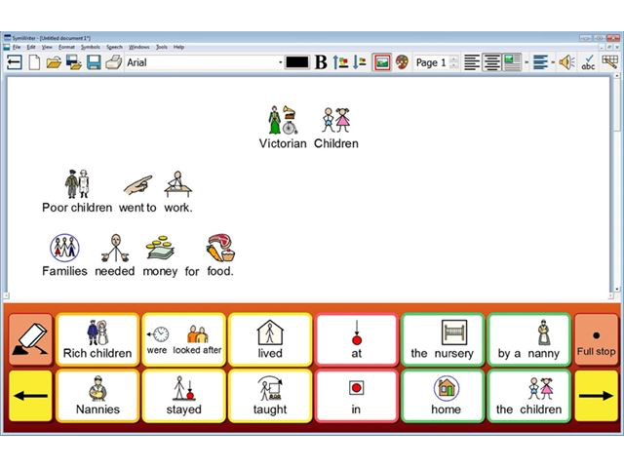

Slide 19
Withdrawal v in class support
Issues:
Child cannot focus as distracted by others in class
Child can be aware that their work is different
The style of interventions I am describing can require lots of activities including moving around and playing games
A quiet environment supports attention levels
Get the balance right – use withdrawal for core learning, make sure inclusion opportunities promote social skills

Slide 20
Creating your own intervention programme
Key factors – repetition, consistent use of language, lots of practice, creates success and motivation
Think about core learning – what do you want to achieve?
Consider the example…

Slide 21
Task 1 – numbers to 5.
1. Use bricks and a cuddly toy (in this case I called the toy Ben). Get a pile of bricks with at least five of each colour – four colours.
Say “ give Ben 2 bricks” – child to count out the right amount of bricks and give them to Ben.
Repeat with different numbers and do each number from 1 to 5 at least twice. Do not do them in numerical order so she cannot rely on knowing what is expected or rote learning.
2. Adult give Ben the bricks – say “how many bricks has Ben got?” child has to count the bricks. Again do in random order at least twice.
3.Adult to place five piles of bricks on table. Put in colour groups. Say to child – “how many yellow bricks?”, “how many blue bricks?”. Do each one at least twice in random order.

Slide 22
Task 2 – prepositions. Child was assessed as knowing in and had some accuracy with under and on.
Use bricks and a box with a lid.
1. Adult place the bricks in positions around the box then ask the question “where is it?” and help child to model:
“it’s behind the box”
“it’s in the box”
“it’s on the box”
“it’s under the box”
“it’s next to the box”
“It’s in front of the box”

Slide 23
Adult can use verbal and physical prompts to cue her in at first.
2. Child to put the bricks in a position and then help her to tell Ben where it is – “Ben, it’s in front of the box”. Do each position at least twice.
3. Put bricks around the box, one in each position. Ask child, “Can you get the one that is behind the box?” She must get the brick and hand it to you saying “this one was behind the box”
Do each position at least twice.

Slide 24
Assessment – are you sure she can really do that?
Challenges:
The TA supports all the time
How much prompting goes on?
How can you establish understanding if the child is not yet recording independently?
Verifying is vital
Over estimating leads to problems in future years
An example – Lucy…

Slide 25
Therefore we need to:
Annotate carefully – look at the example

Slide 26
Sample from annotation guide
“Please ensure that all of Maisie’s work is annotated to support assessment and monitor progress.
Literacy or writing tasks:
Highlight any writing in pink if Maisie was given the spelling or used predictive text.
Highlight is writing in yellow if it is Maisie’s own attempt at spelling.
Highlight in pink if Maisie has been given input with punctuation.
Highlight in yellow if Maisie has put in her own punctuation

Slide 27
Annotation sample cont…
Put comments either at the side of the page, or on a post-it note if you prefer, that explain how much help Maisie has had.
For example:
Maisie required lots of prompts to sequence her ideas or thoughts
Maisie could think of sentences but needed help with spelling
Maisie was able to use symbols to sequence the facts and she could explain what had happened in the correct order
Maisie could not recall the vocabulary so we used the word bank
Maisie required a few prompts but wrote this independently
Maisie used ideas from the whiteboard to generate her sentences but worked independently

Slide 28
Maths annotation – examples of comments
Maisie needed help from the adult to set out her sums / draw a diagram but did not need any help with calculations
Maisie managed to add numbers 1 to 5 but made errors with 6 and 7 – she does not know these ones
Maisie required an adult scribe to complete the last few sums and speed her up
Maisie completed the task independently using ICT
Maisie needed help with the maths problems in order to decide how to tackle the problem in step-by-step approach

Slide 29
Assessing accurately – think about…
Using other recording systems as adults – create feedback forms
Checking if learning is being generalised – can the child use a spelling in a sentence once they have learned it on a flash card?
Can they do the sums if you muddle them up?
Showing learning in different ways – photos, videos, practical tasks, mind maps, witness statements
Revisiting to see if the child has retained learning
Being honest, even if it means being negative

Slide 30
Assessment tools
PIVATS (https://www.pivats.co.uk)
B SQUARED (https://www.bsquared.co.uk)
Using the most appropriate year group descriptors with lots of details and annotation
Create a portfolio with examples
Build up an evidence trail of checklists, samples, proof

Slide 31
Role of the teaching assistants
These can be key staff in school but they do not lead the planning for the child – this remains the responsibility of the teacher.
Key words for the TAs:
Facilitate Feedback Resources
Evaluate Share Evidence
Support Annotate
Reflect Suggest

Slide 32
Challenges for TAs and /or teachers
“There is no time for feedback – the TA goes home at the same time as child”
“The TA withdraws the child so I don’t know how she does the reading programme”
“I am not sure about the child’s levels”
“The TA sees mum much more than me so I don’t have a relationship with her”
“The TA is so protective that the child is missing out on some activities”
“I don’t have time to make resources so time is lost in lessons dashing to the photocopier”

Slide 33
Role of The T.A
To facilitate learning – this includes modifying resources in advance – time is needed to discuss planning and how the child will access the activity
To provide written and verbal feedback and ensure the teacher is fully aware of progress and challenges
To allow others e.g. peers or other less familiar adults, to assist the child to reduce learned helplessness
To be motivating but realistic and honest about abilities / limitations.
To promote independence but not if this means using “filler activities”

Slide 34
Linking up with therapists / specialist teachers
TAs should always go with the child to a specialist session, if they are not needed to directly support then they should make notes and feedback to the teacher
They should ask why the therapist is doing a task – “what are the benefits and how can I reinforce them back in class?”
The aim is to generalise approaches and apply them consistently

Slide 35
The adults supporting should not…
Become the protector
Do the work or other things for him /improve quality/over-help
Speak for him / finish sentences /assume he is right / over prompt
Subconsciously encourage patronising behaviours/attitudes in other children

Slide 36
Times to promote independence
Putting on coat, hat, gloves
Moving around
Getting resources
Getting her snack
Tidying up, putting wrappers in bin
Putting things in school bag
Using iPad to take a photo / video

Slide 37
Independence
No bird soars too high, if he soars with his own wings.
William Blake

Slide 38
Homework and partnership working
These children need lots of repetition and over- learning
Homework has to be manageable and fun
Parents need to know the approaches being used and ensure consistency
Parental feedback is as important as TA feedback
Parents need more regular contact to keep up with progress and challenges

Slide 39
Where has the time gone??

